Slide 1




List Of Political Parties Participated During-2024 Source: : https://www.data.gov.in/resource/list-political-parties-participated-during-2024 Dataset: PoliticalParties.csv Email: lakshmiswetha0048@gmail.com Phone : 8919052265 LinkedIn : https://www.linkedin.com/in/lakshmi-swetha-narapuram-01463b286
List Of Political Parties Participated during 2024 Using PySpark
Mundrika Tejasri

Slide 2
Introduction
The Political Parties Analytics 2024 project focuses on analyzing the dataset of parties that contested in the 2024 elections. The dataset includes essential attributes such as Party Type, Abbreviation, Party Symbol, and Party Name, which together provide valuable insights into how political organizations are identified, classified, and represented across India’s democratic landscape.
This analysis aims to highlight the diversity of party structures, the uniqueness of their symbols and abbreviations, and the naming patterns that reflect historical, cultural, and ideological foundations. By studying parameters like party type distribution, uniqueness of identifiers, name length variation, and symbolic representation, the project uncovers how parties establish their identity and branding to appeal to voters.
The study also emphasizes the balance between National and Regional parties, which reflects the federal character of India’s democracy. National parties project centralized leadership and large-scale influence, while state and regional parties ensure that local aspirations and identities remain part of the political process.
Through structured analysis and visualizations such as bar charts, pie charts, and histograms, this project provides a comprehensive overview of the 2024 electoral landscape, offering insights into political competition, representation, and voter recognition strategies.

Slide 3
Initial Analysis of the Dataset
Political Parties Participated in 2024 – Initial Analysis
The dataset contains records of 745 political parties across 5 variables, capturing party type, abbreviation, symbol, and official name. The absence of missing values and duplicate entries ensures that the dataset is reliable for electoral analysis.
1. Party Landscape Snapshot:The dataset represents 745 political parties.Types of Parties: National, State, and Regional.National parties hold greater visibility and influence, while the large number of regional parties reflects India’s federal structure and localized democracy.This balance highlights a competitive system, where both centralized and localized forces shape electoral politics.
2. Party IdentifiersAbbreviations: Short forms like BJP, INC, AAP, BSP are widely used across ballots, campaigns, and media.Symbols: Assigned by the Election Commission for identification, they range from:Animals → Elephant, Lion, Tiger (strength and leadership).Objects → Hand, Lotus, Broom (cultural, familiar, and memorable).Tools/Ideological icons → Hammer, Sickle, Star (movements, struggles, ideology).These identifiers are critical, especially in rural areas where literacy may affect name recognition.

Slide 4
Initial Analysis of the Dataset
3. Party Names and Trends:Length: Names vary from short and catchy to long and descriptive.Common Words: “Congress”, “Janata”, and “Indian” appear frequently, showing recurring themes in political identity.Alphabetical Patterns: Initials like I, B, and C are dominant, pointing to naming conventions tied to national identity and ideology.
4. Symbol Categories and Significance:Animals symbolize strength, authority, and leadership.Objects emphasize simplicity and cultural connection.Tools/Ideology symbols link to workers’ movements, struggles, or values.National parties often adopt simple, recognizable icons, while regional parties emphasize local imagery to appeal to specific voter bases.
5. Participation Distribution:National vs Regional split shows that regional parties form a significant share, ensuring diverse representation.This distribution reflects India’s multi-party democracy, where both large and small parties shape electoral competition.Suggested visualizations:Bar chart → Party type distribution.Pie chart → National vs Regional share.Histogram → Name length distribution.

Slide 5
Initial Analysis of the Dataset
6. Voter Connection Insights:Symbols remain the most powerful identifiers, bridging the literacy gap.Abbreviations ensure ease of recognition in ballots and media.Parties with unique, simple identifiers likely enjoy stronger recall among voters.Repeated use of certain words (Indian, Janata, Congress) builds on historic recognition but may reduce uniqueness.
7. Political Branding and Positioning:Parties invest in branding through names and symbols.Shorter names and clear symbols provide electoral advantage.Regional parties leverage local identity and imagery, while national parties focus on simple, universal symbols.

Slide 6
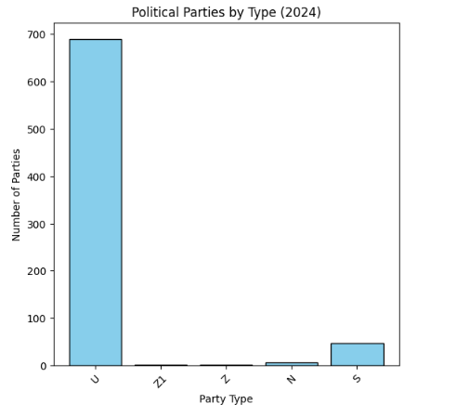
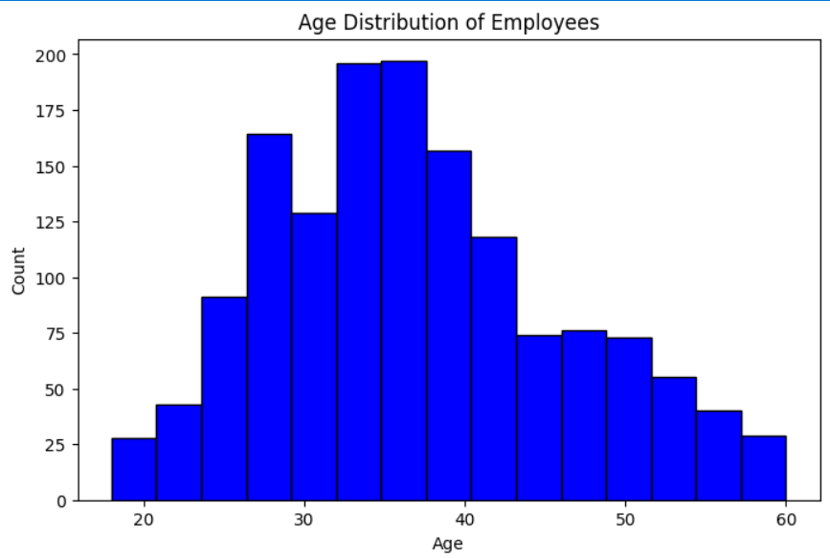
Number Of Parties
The dataset of 745 political parties is dominated by 690 unrecognized parties, showing the prevalence of smaller outfits.There are 47 state parties with regional influence and only 6 national parties with nationwide recognition.Two rare classifications, Z and Z1, have just one party each, reflecting unique or transitional categories.

Slide 7
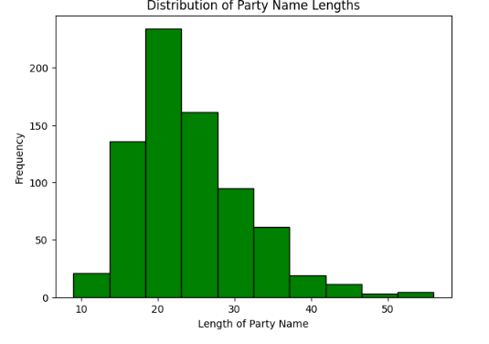
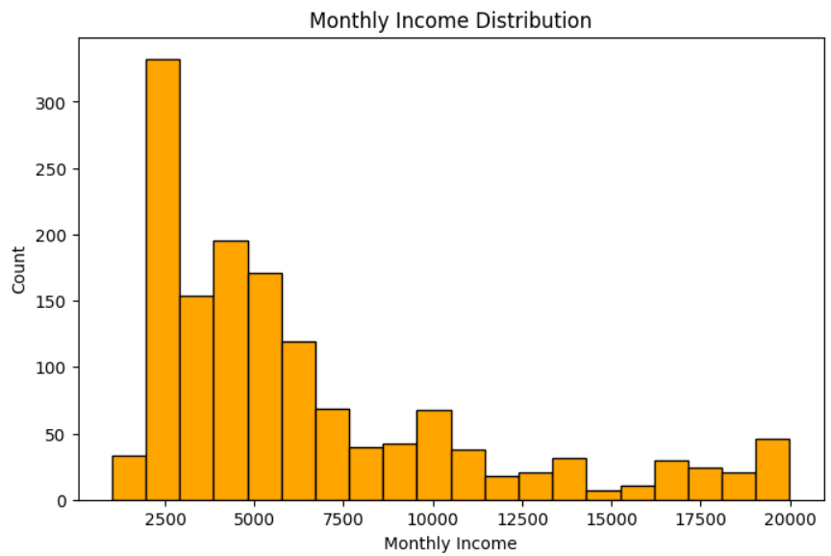
Distribution Of Party Name Lengths
The most common length for a party name is between 20 and 25 characters, with a frequency exceeding 200.The distribution is right-skewed, indicating that the majority of party names are relatively short, with fewer very long names.Party names longer than 45 characters are extremely rare, showing a frequency of less than 10.

Slide 8
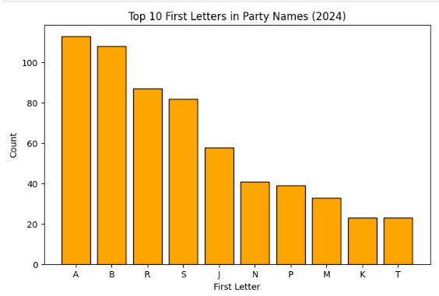
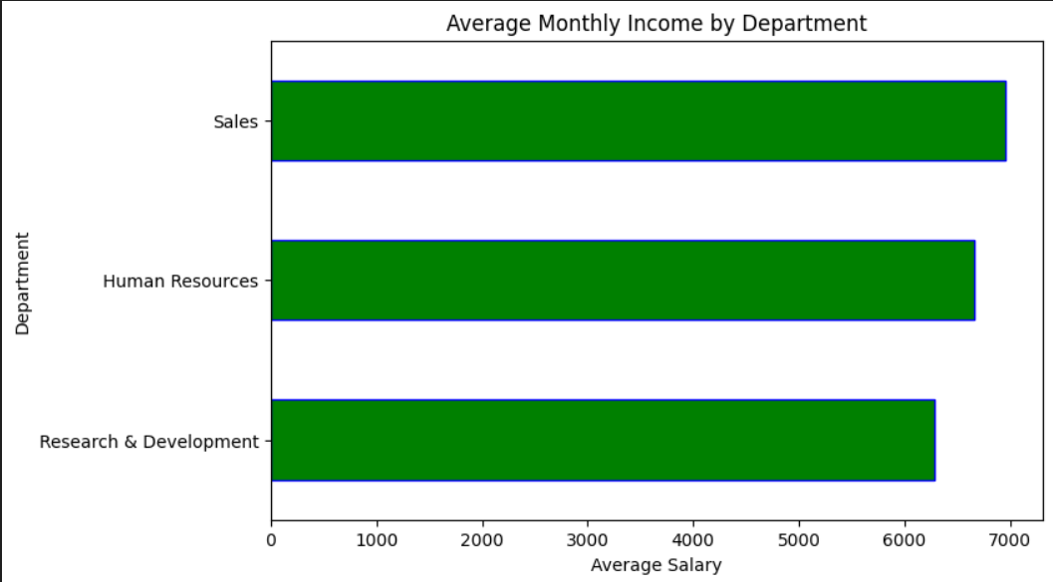
Top First Letters In Party Names
The letters 'A' and 'B' are the most common starting letters for party names, each exceeding a count of 100.The top four starting letters ('A', 'B', 'R', 'S') collectively have significantly higher counts (over 80 each) compared to the remaining six.The letters 'K' and 'T' are the least frequent among the top 10, with counts of approximately 22.

Slide 9
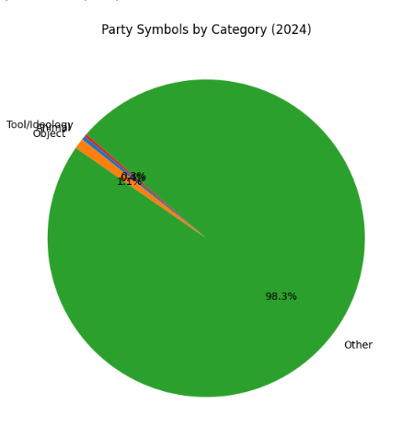
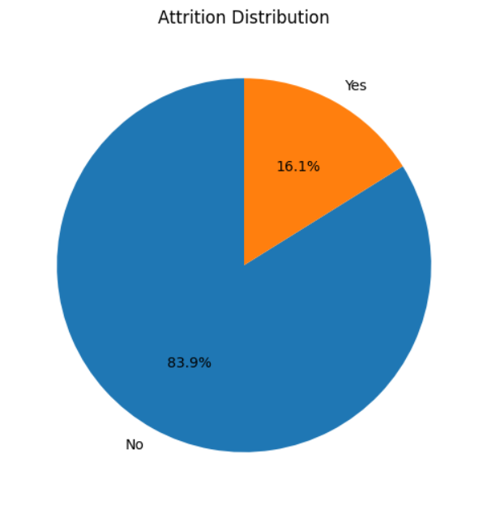
Party Symbol By Category
An overwhelming majority of party symbols fall into the "Other" category, accounting for 98.3% of all symbols.The categories of "Tool/Ideology" and "Object" represent a tiny fraction of the total symbols, with 0.4% and 1.1% respectively.This distribution suggests that party symbols are highly diverse and rarely fit into the specific, pre-defined categories of "Tool/Ideology" or "Object."

Slide 10
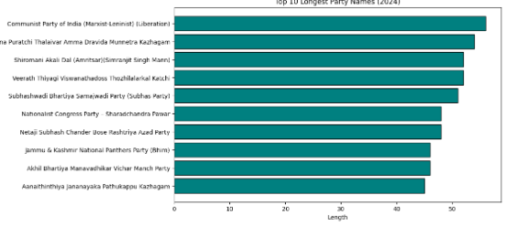
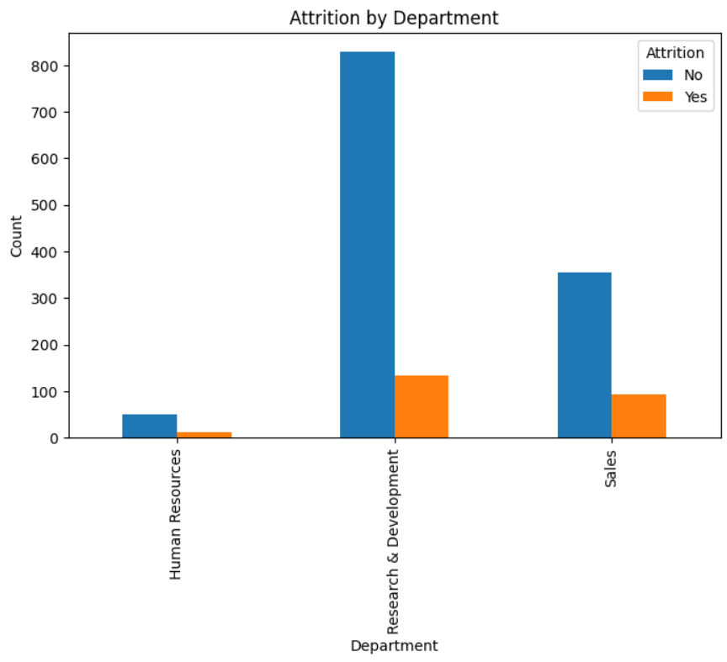
Top Longest Party Names
The longest party name belongs to the Communist Party of India (Marxist-Leninist) (Liberation), with a length exceeding 55 characters.All of the top 10 longest party names are significantly long, with all names exceeding 45 characters in length.The lengths among the top 10 are clustered together, ranging from approximately 45 to 57 characters, indicating that the longest names are all of comparable size.

Slide 11
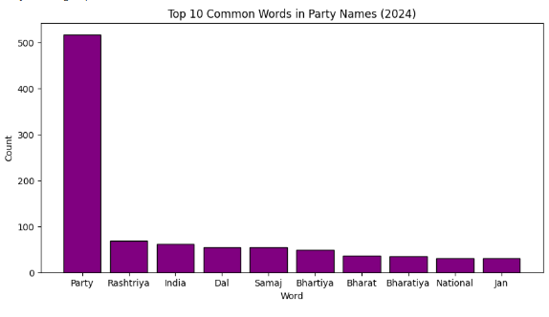
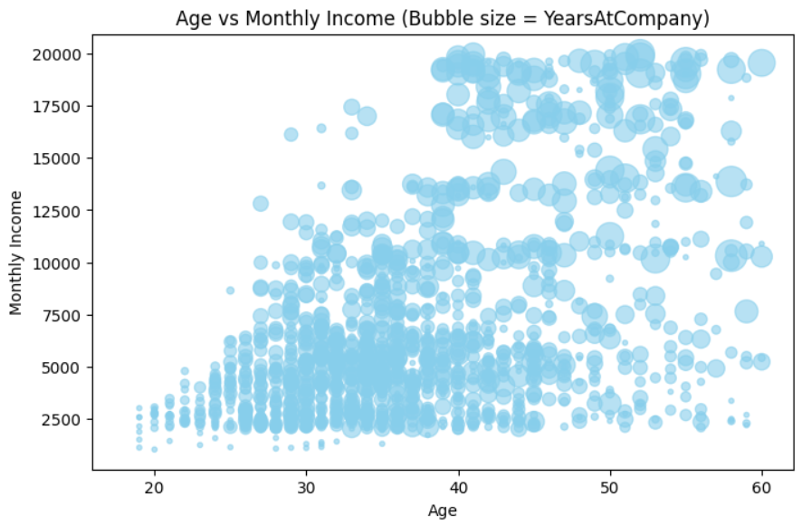
Common Words In Party Names
The word "Party" is by far the most common word, appearing over 500 times, which is more than seven times the count of the next most frequent word.The words "Rashtriya" and "India" are the next most common, with counts of around 70 and 60 respectively, forming a small secondary cluster.The remaining words in the top 10, such as "Dal," "Samaj," "Bhartiya," "Bharat," "Bharatiya," "National," and "Jan," all appear with low and relatively similar frequencies, ranging from approximately 30 to 50.

Slide 12
Dataset Observation
Structure and Size: The dataset contains 745 entries and 5 columns, with no missing values across any of the columns.
Key Columns and Data Types: All columns, except for the serial number, are stored as strings (object type):
Party Name: The full name of the political party.
Abbreviation: The acronym or short form of the party name.Party
Symbol: The symbol officially associated with the party (e.g., 'Lotus', 'Hand’).
Party Type: A category indicating the type of party (e.g., 'N' for National, as seen in the initial rows).
Content: The data provides foundational information on political entities, which is suitable for text analysis (e.g., word frequency, name length, abbreviation patterns) and categorical analysis of party types and symbols.

Slide 13
Dataset Observation
Symbol Frequency
Analysis of the Party Symbol column shows high repetition of specific symbols, suggesting they are common 'free symbols' made available for lesser-known parties.
The most common symbol is 'Auto-rickshaw' (35 parties).
Other highly repeated symbols include 'Ganna kisan' (25) and 'Gas cylinder' (24).
Correlation with Visualizations
Party Name Length : Names are generally short, but the few long names (up to ~57 characters) belong to parties where the name is highly descriptive (e.g., specific communist factions).
Common Words : The extreme frequency of the word "Party" (over 500 counts) confirms the descriptive titles of the entries in the Party Name column.
Symbol Categories (Screenshot 146):
The vast majority of symbols being categorized as "Other" (98.3%) directly relates to the diversity and lack of predefined major categories among the 700+ unique symbols.

Slide 14
Conclusion
This comprehensive dataset details the political landscape by listing 745 distinct political parties with attributes including their type, abbreviation, symbol, and name, exhibiting perfect data integrity with no missing values. The analysis reveals a landscape overwhelmingly dominated by localized and smaller groups, as 92.62% of all entries are categorized as Unrecognized ('U') parties, contrasting sharply with the mere 6 National ('N') parties. This fragmentation is also evident in party naming, where the word "Party" is by far the most common term, and in the usage of symbols, which are highly diverse yet frequently shared (like the 'Auto-rickshaw'), suggesting that many political entities rely on generic "free symbols" made available by electoral bodies.

